Slide 1
AWARE-AI Spring Roundtable: AI’s Presence in Accessible Computing March 5, 2024
www.rit.edu/nrtai

Slide 2

The AWARE-AI NRT is a program funded by the
National Science Foundation.
Trainees experience career-advancing activities and events addressing skill gaps in AI, and convergent AI research with faculty in four research tracks:
Software - Hardware - HCI - Cognitive Modeling
Trainees develop their network in a research community.

Slide 3


How to apply at rit.edu/nrtai
Application due March 1 on the AWARE-AI website
Application form
CV (uploaded in form)
Cover letter (uploaded in form)
One letter of recommendation (if applicable, from advisor) sent to awareainrt@rit.edu by March 1
Prospective or current MS and Ph.D. students can contact awareainrt@rit.edu for more information.
Advisees can apply without advisor being an NRT affiliate. Advisor or program director indicates support for participation in their letter.
Currently, 18 eligible PhD or MS programs at RIT (see website)
All students in these program are eligible to apply.
Applicants also eligible for stipends will be automatically considered.
$34,000
fellowship
opportunity
Up to
$1,440
conference
travel
Seed
funding
grants
Career enhancing
internships and visits

Slide 4
Topic Focus
This AWARE-AI Spring Roundtable focuses on AI’s presence in accessible computing. The discussion will focus on the latest research, current concerns and challenges, and what's on the horizon.

Slide 5
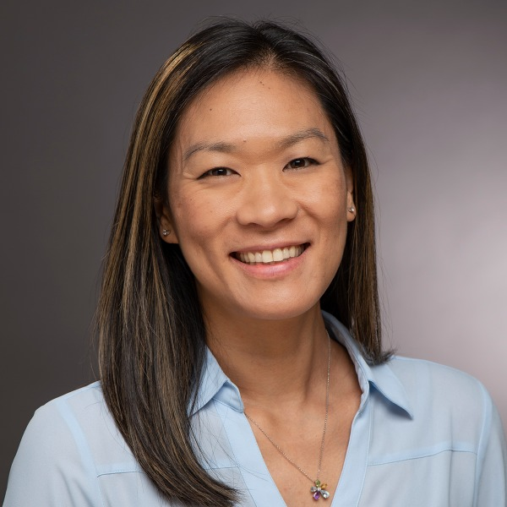
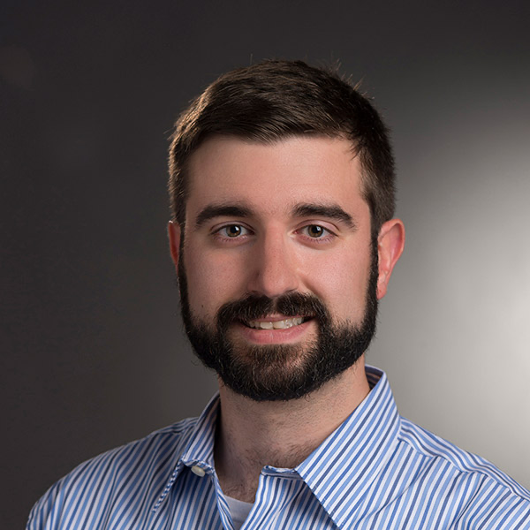

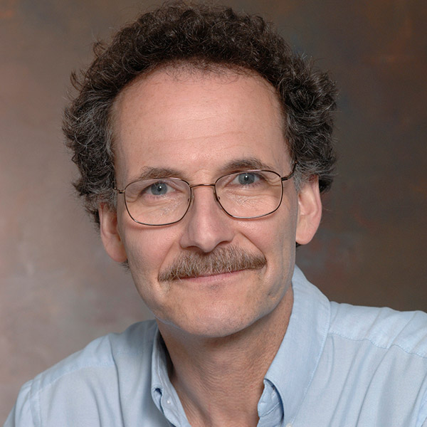
Roundtable panelists
Jason Nordhaus, Ph.D, Associate Prof., School of Mathematics and Statistics, RIT
Kristen Shinohara, Ph.D, Associate Prof., School of Information, RIT
Dan Phillips, Ph.D, Associate Prof., Department of Electrical and Microelectronic Engineering, RIT
Jason
Kristen
Dan

Slide 6
Overarching Questions
What are some of the most groundbreaking AI technologies that have recently been developed or are in development to enhance accessible computing?
What ethical considerations should researchers prioritize to ensure AI innovations are inclusive and do not exacerbate existing inequalities or harm?
Accessible computing benefits from interdisciplinary research. Can you share any interdisciplinary collaborations that has led to innovative AI applications?
One challenge in AI development is creating models without biases. What strategies are being employed to ensure AI systems are inclusive?
Looking forward, what emerging technologies or research methods do you believe will be most influential in shaping the future of AI in accessible computing? How can current graduate students position themselves to contribute to these future developments?

Slide 7
Thank you!
This material is based upon work supported by the National Science Foundation under Award No. DGE-2125362. Any opinions, findings, and conclusions or recommendations expressed in this material are those of the author(s) and do not necessarily reflect the views of the National Science Foundation.

Slide 8
Questions?

